Slide 1

Clauses 7-10 Of ISO27001:2013 (ISMS)
Lets have a look at clauses 7-10

Slide 2

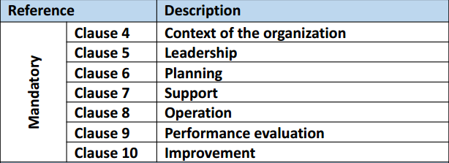
Clauses 7-10 Of ISO27001:2013 (ISMS)
ISO27001:2013 MANDATORY CLAUSES
https://chapters.theiia.org/bermuda/Events/ChapterDocuments/Information%20Security%20Management%20System%20%28ISMS%29%20Overview.pdf

Slide 3
Clauses 7-10 Of ISO27001:2013 (ISMS)
7: Support
Org shall provide the resources necessary for the establishment, implementation, maintenance and continual improvement of the ISMS
Ensure competence of staff for the ISMS

Slide 4
Clauses 7-10 Of ISO27001:2013 (ISMS)
7: Support
Awareness related to the policy and ISMS will be ensured among staff
Communication mechanisms related to ISMS internal and external to the org

Slide 5
Clauses 7-10 Of ISO27001:2013 (ISMS)
7: Support
Documentation with appropriate identification, description, format, review & approval mechanism
Documentation change control, protection, distribution, retention, & disposal

Slide 6
Clauses 7-10 Of ISO27001:2013 (ISMS)
8: Operations
Plan, implement, and control processes
Control planned changes
Outsourced processes controlled
Risk assessment and risk treatment & retain documented information

Slide 7
Clauses 7-10 Of ISO27001:2013 (ISMS)
9: Performance Evaluation
Monitoring, measurement, analysis, and evaluation
What needs to be monitored, methods, who will monitor, when to monitor, who shall analyze and evaluate results ?

Slide 8
Clauses 7-10 Of ISO27001:2013 (ISMS)
9: Performance Evaluation
Internal audit implemented at planned intervals
Define audit criteria and scope for each audit
Reporting of auditing results
Retain auditing docs

Slide 9
Clauses 7-10 Of ISO27001:2013 (ISMS)
9: Performance Evaluation
Internal audit implemented at planned intervals
Define audit criteria and scope for each audit
Reporting of auditing results
Retain auditing docs

Slide 10
Clauses 7-10 Of ISO27001:2013 (ISMS)
9: Management Review
Planned intervals
Status of actions
Changes in external and internal environment
Review non-conformities and corrective actions, monitoring & measurement results, audit reports, other

Slide 11
Clauses 7-10 Of ISO27001:2013 (ISMS)
10: Improvement
Non-conformities and corrective actions
Continual improvement
END

